Slide 1
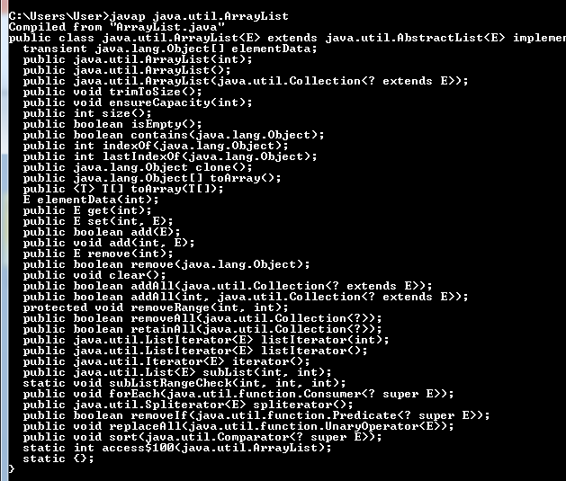
javap tool
The javap command disassembles a class file. The javap command displays information about the fields, constructors and methods present in a class file.
javap fully_class_name

